Slide 1
Welcome to
Hodder Class

Slide 2
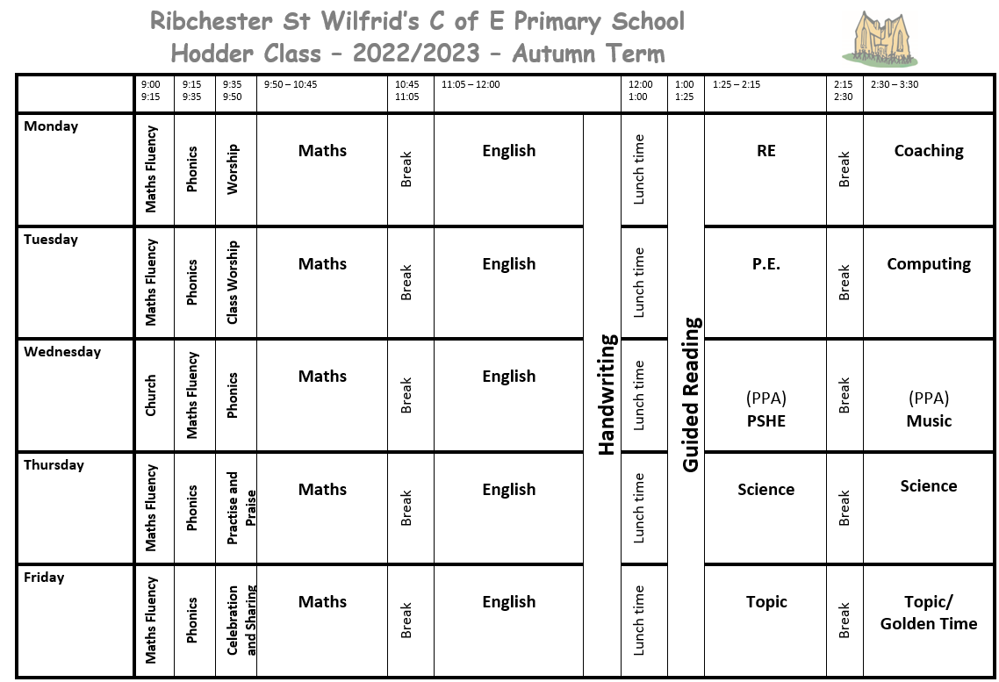

Slide 3
Curriculum
Autumn Term – Explorers
Significant people
Living things and their habitats
Small area in a non-European country
Spring Term – Highway Rat
The United Kingdom
Farming
Animal – humans
Summer Term – Fire! Fire!
Events beyond living memory
Animals – survival and growth

Slide 4
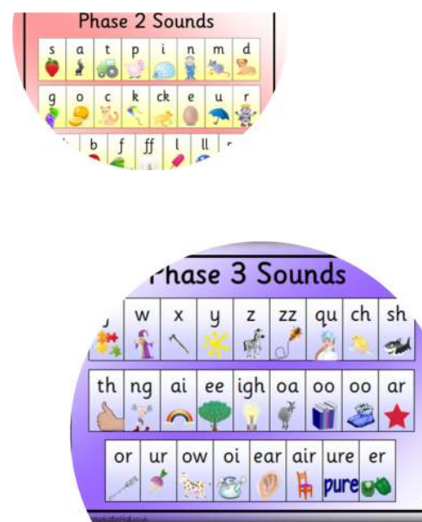
Phonics screening – Year 1
June 2023
Testing children’s ability to segment and blend words
Class teacher administers the test
Pass rate 32/40
Test results will be given in end of year report

Slide 5
Reading Books
Children will get one book at a time
Book changing days – Monday and Thursday
Spellings
Year 2 have a spelling book
Children will get spellings for the week on a Friday and have a spelling test the following Friday

Slide 6
PE
Every Monday and Tuesday
Times tables
Every Friday – small test- 2s, 5s and 10s

Slide 7
Class rules and expectations
Aim for the gold star
Class dojo points – reward when reach 20 points
Headteachers award – every Friday
In our class we… are kind, are helpful, are good listeners and always try our best!

